Slide 1

Personalized Weather Station
By: Shival Panchal & Joshua Chary
8
May
2026

Slide 2
Motivation?
Weather affects daily decisions
Existing systems can be expensive or oversized
Goal was to create a compact personalized monitoring device
Learn schematic capture, layout, and design rule verification
Learn full PCB manufacturing workflow from concept to implementation
Simulate a real product development cycle from concept to manufacturable design
Confidential

Slide 3
Objectives:
Measure environmental conditions
Design a custom PCB
Integrate sensors and microcontroller
Manufacture and assemble the board
Validate functionality through testing
Create a compact and reliable system
Try implementing a regression model to predict the future weather conditions

Slide 4
Critical Components:
● ATmega328P-A — core microcontroller handling sensing, processing, and communication
● BME280 — environmental sensor measuring temperature, humidity, and pressure
● CH340C — USB-to-serial communication interface
● Dual USB-C Connectors — dedicated power and communication interfaces
● LD1117S33TR — 3.3V voltage regulator
● Crystal Oscillator — provides stable MCU timing
● ISP Header — used for firmware programming
● Test Points — used for debugging and validation
● Status LED — visual activity indicator

Slide 5
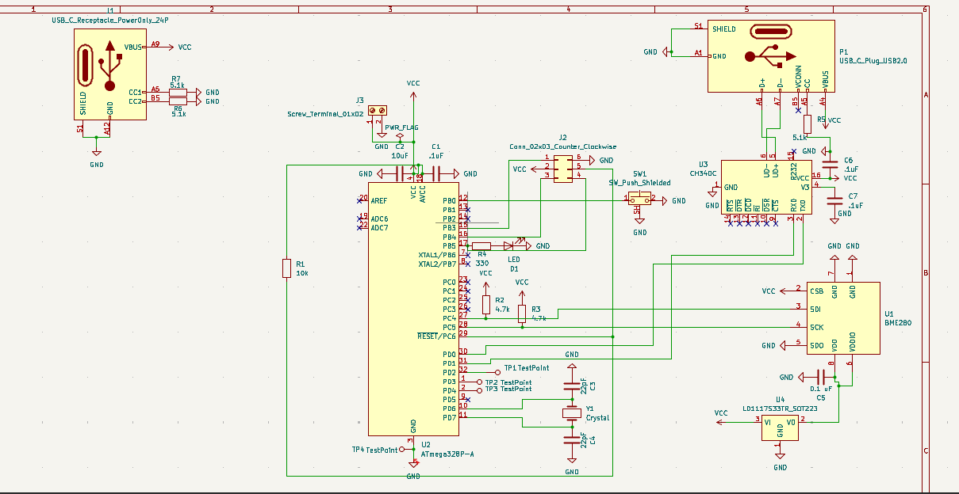
Schematic:

Slide 6
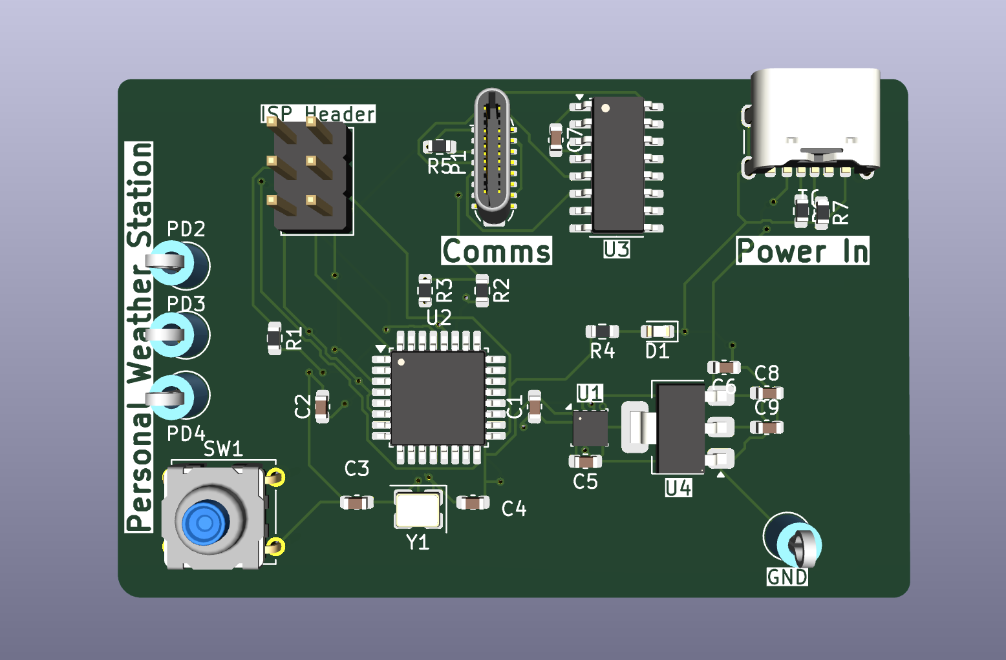
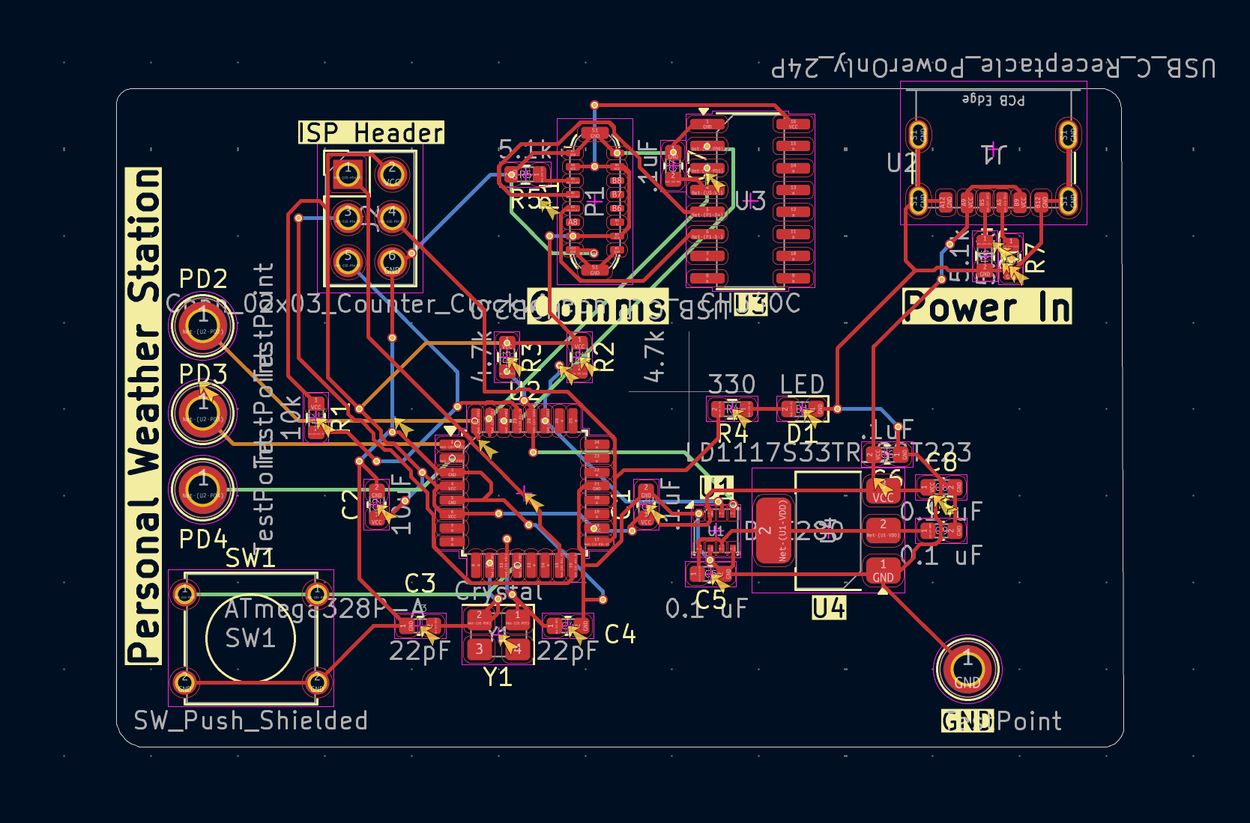
PCB Design:

Slide 7
Design Challenges:
Initial proof of concept used a DHT22 — functioned correctly and validated the sensing approach
BME280 was damaged during early testing due to incorrect pin labeling — pins were misidentified causing improper connections
Partner completed initial PCB layout, brought in for design review — identified missing decoupling and bulk capacitors and added them
Test points added to GND and sensor lines during review to allow probing for future sensor swaps or debugging
Once BME280 was correctly wired and operational, DHT22 was dropped entirely in favor of the more capable sensor
After finalizing edits, experimented with converting the board to a 4-layer stackup
Learned how to assign vias to specific layers and route signals across inner copper layers
Gained hands-on understanding of how 4-layer boards are structured beyond standard 2-layer design

Slide 8
Manufacturing Readiness
All components are commercially available — Arduino, BME280, passives, connectors, crystal
Gerber files can be submitted directly to any PCB fab house (JLCPCB, PCBWay, OSHPark)
Board is fully functional as designed — can be ordered, assembled, and operational without any design changes
Test points ensure easy validation immediately after assembly

Slide 9
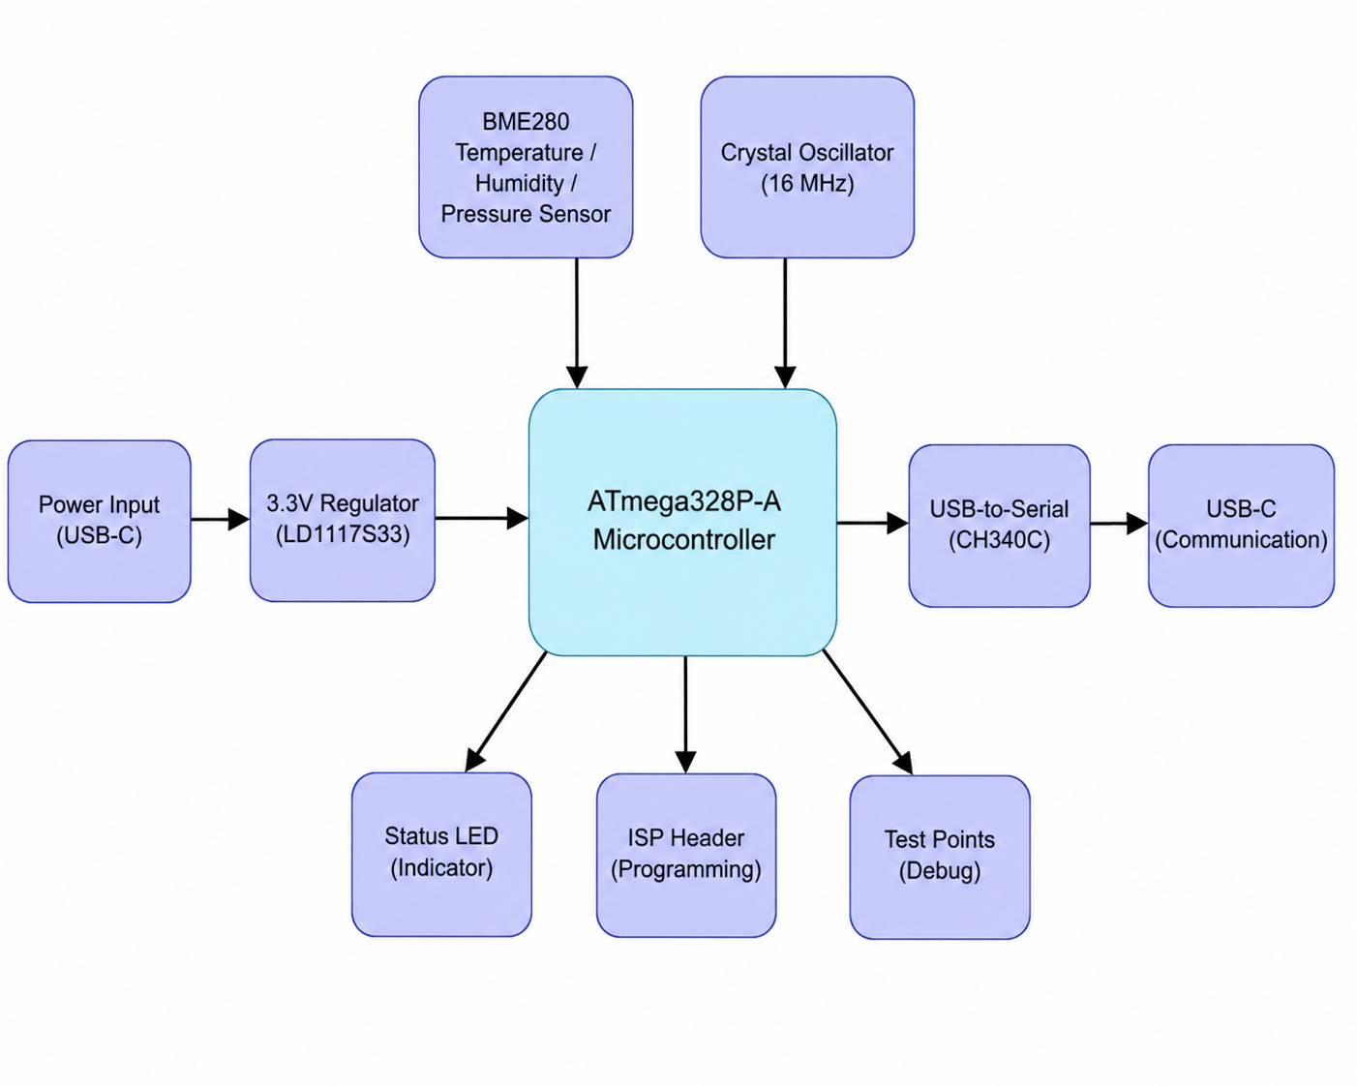
How Does this Product Work?
Program will collect data from the device, and push notifications to the User
User Will Plug the device into their computer (via USB)
User will install our computer application
User will run the program

Slide 10
What is our product doing?
ATmega328P-A collects environmental data through the BME280
Computer Program collects data through USB serial communication
Python receives data and graphs actual values
Python Predicts future trends and classifies a weather condition

Slide 11
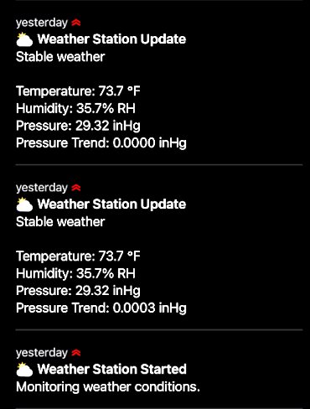
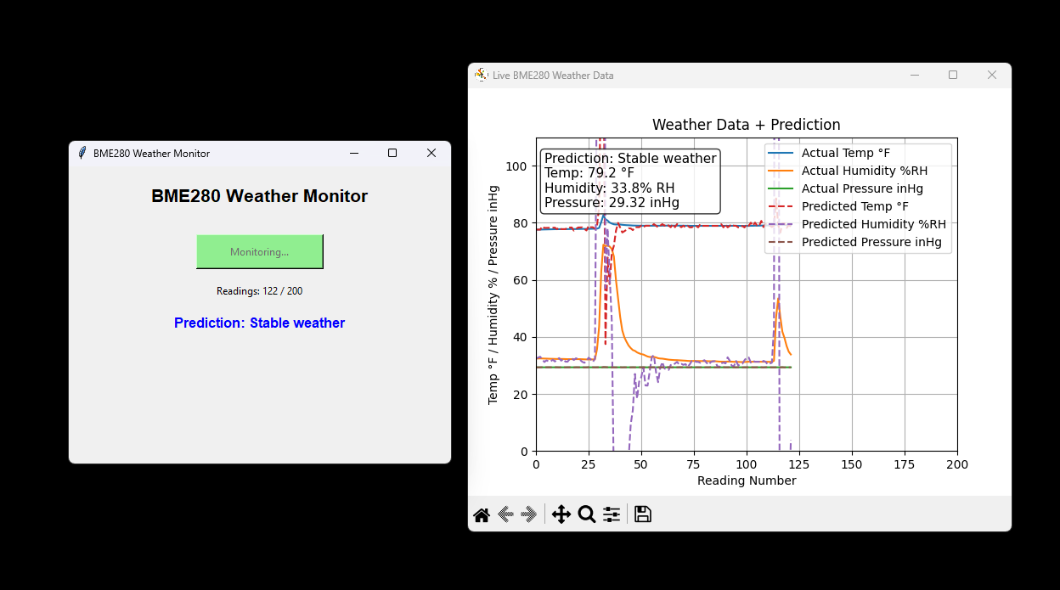
User Interface / Data Collection

Slide 12

Mini Demonstration:

Slide 13
Conclusion:
Successfully completed a full PCB design cycle from schematic capture to manufacturable layout in KiCad
Hands-on experience with real engineering challenges — damaged components, design reviews, and iterative fixes
Learned 4-layer board design, via management, decoupling strategy, and SPI sensor interfacing
Project has direct real-world application — already being used in a professional environment for environmental monitoring
Demonstrated that good engineering is iterative — the final design is stronger because of every mistake made along the way

